Slide 1
Probability Review and Naïve Bayes
Instructor: Alan Ritter
Some slides adapted from Dan Jurfasky and Brendan O’connor

Slide 2
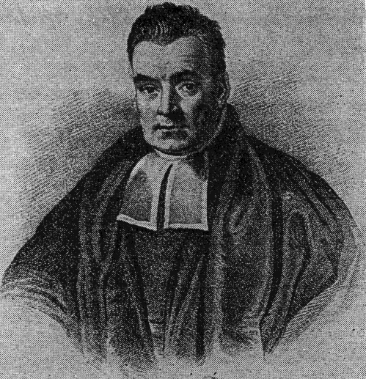
What is Probability?
“The probability the coin will land heads is 0.5”
Q: what does this mean?
2 Interpretations:
Frequentist (Repeated trials)
If we flip the coin many times…
Bayesian
We believe there is equal chance of heads/tails
Advantage: events that do not have long term frequencies
Q: What is the probability the polar ice caps will melt by 2050?

Slide 3
Probability Review
Conditional
Probability
Chain Rule

Slide 4
Probability Review
Disjunction / Union:
Negation:

Slide 5
Bayes Rule
Hypothesis
(Unknown)
Data
(Observed Evidence)
Generative Model of How Hypothesis Causes Data
Bayesian Inferece
Bayes Rule tells us how to flip the conditional
Reason about effects to causes
Useful if you assume a generative model for your data

Slide 6
Bayes Rule
Bayes Rule tells us how to flip the conditional
Reason about effects to causes
Useful if you assume a generative model for your data
Likelihood
Prior
Posterior
Normalizer

Slide 7
Bayes Rule
Bayes Rule tells us how to flip the conditional
Reason about effects to causes
Useful if you assume a generative model for your data
Likelihood
Prior
Posterior
Normalizer

Slide 8
Bayes Rule
Bayes Rule tells us how to flip the conditional
Reason about effects to causes
Useful if you assume a generative model for your data
Likelihood
Prior
Proportional To
(Doesn’t sum to 1)
Posterior

Slide 9
Bayes Rule Example
There is a disease that affects a tiny fraction of the population (0.01%)
Symptoms include a headache and stiff neck
99% of patients with the disease have these symptoms
1% of the general population has these symptoms
Q: assume you have the symptom, what is your probability of having the disease?

Slide 10
Text Classification

Slide 11
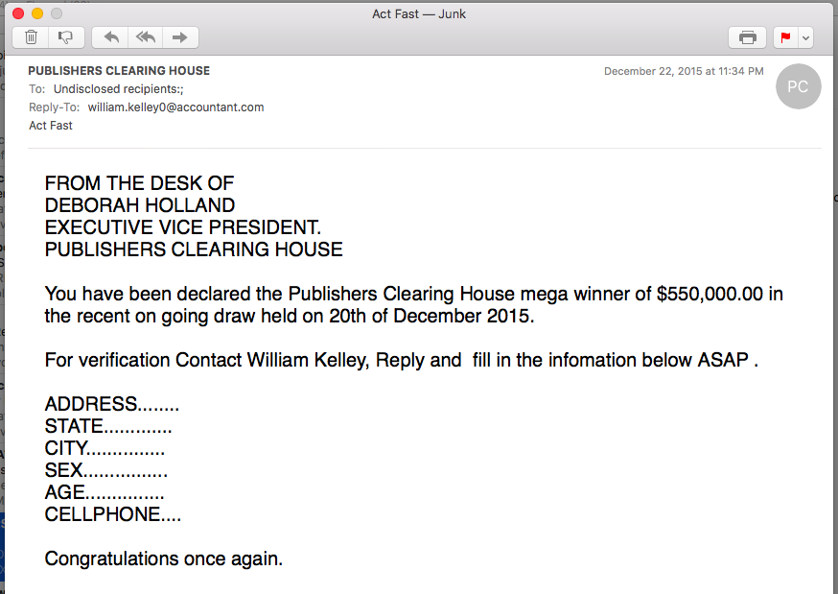
Is this Spam?

Slide 12
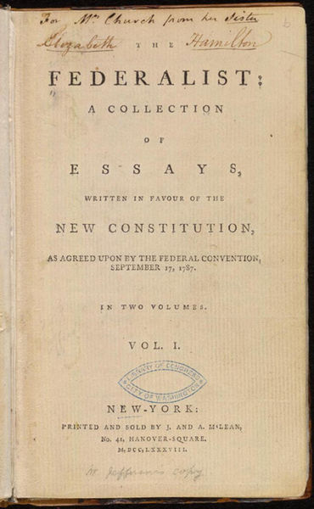
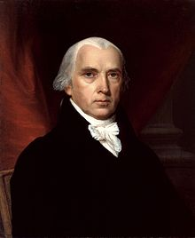
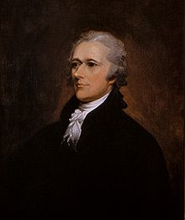
Who wrote which Federalist papers?
1787-8: anonymous essays try to convince New York to ratify U.S Constitution: Jay, Madison, Hamilton.
Authorship of 12 of the letters in dispute
1963: solved by Mosteller and Wallace using Bayesian methods
James Madison
Alexander Hamilton

Slide 13
What is the subject of this article?
MEDLINE Article
MeSH Subject Category Hierarchy
Antogonists and Inhibitors
Blood Supply
Chemistry
Drug Therapy
Embryology
Epidemiology
…

Slide 14


Positive or negative movie review?
unbelievably disappointing
Full of zany characters and richly applied satire, and some great plot twists
this is the greatest screwball comedy ever filmed
It was pathetic. The worst part about it was the boxing scenes.

Slide 15
Text Classification: definition
Input:
a document d
a fixed set of classes C = {c₁, c₂,…, c_{J}}
Output: a predicted class c ∈ C

Slide 16
Classification Methods: Hand-coded rules
Rules based on combinations of words or other features
spam: black-list-address OR (“dollars” AND “have been selected”)
Accuracy can be high
If rules carefully refined by expert
But building and maintaining these rules is expensive

Slide 17
Classification Methods: Supervised Machine Learning
Input:
a document d
a fixed set of classes C = {c₁, c₂,…, c_{J}}
A training set of m hand-labeled documents (d₁,c₁),....,(d_{m},c_{m})
Output:
a learned classifier γ:d → c

Slide 18
Classification Methods: Supervised Machine Learning
Any kind of classifier
Naïve Bayes
Logistic regression
Support-vector machines
k-Nearest Neighbors
…

Slide 19
Naïve Bayes Intuition
Simple (“naïve”) classification method based on Bayes rule
Relies on very simple representation of document
Bag of words

Slide 20
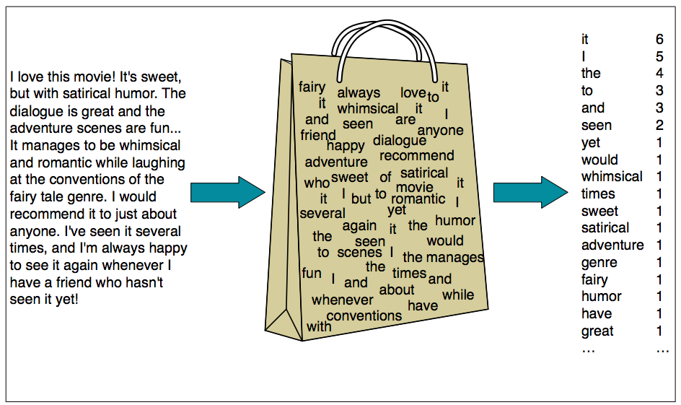

Slide 21
Bag of words for document classification
?
Test
document
Machine Learning
NLP
Garbage
Collection
Planning
GUI
parser
language
label
translation
…
learning
training
algorithm
shrinkage
network...
parser
tag
training
translation
language...
garbage
collection
memory
optimization
region...
planning
temporal
reasoning
plan
language...
...

Slide 22
Bayes’ Rule Applied to Documents and Classes
For a document d and a class c

Slide 23
Naïve Bayes Classifier (I)
MAP is “maximum a posteriori” = most likely class
Bayes Rule
Dropping the denominator

Slide 24
Naïve Bayes Classifier (II)

Slide 25
Naïve Bayes Classifier (IV)
O(|X|^{n}•|C|) parameters
How often does this class occur?
Could only be estimated if a very, very large number of training examples was available.
We can just count the relative frequencies in a corpus

Slide 26
Multinomial Naïve Bayes Independence Assumptions
Bag of Words assumption: Assume position doesn’t matter
Conditional Independence: Assume the feature probabilities P(x_{i}|c_{j}) are independent given the class c.

Slide 27
Multinomial Naïve Bayes Classifier

Slide 28
Applying Multinomial Naive Bayes Classifiers to Text Classification
positions ← all word positions in test document

Slide 29
Learning the Multinomial Naïve Bayes Model
First attempt: maximum likelihood estimates
simply use the frequencies in the data

Slide 30
Parameter estimation
fraction of times word w_{i} appears
among all words in documents of topic c_{j}
Create mega-document for topic j by concatenating all docs in this topic
Use frequency of w in mega-document

Slide 31
Problem with Maximum Likelihood
What if we have seen no training documents with the word fantastic and classified in the topic positive (thumbs-up)?
Zero probabilities cannot be conditioned away, no matter the other evidence!

Slide 32
Laplace (add-1) smoothing for Naïve Bayes

Slide 33
Multinomial Naïve Bayes: Learning
Calculate P(c_{j}) terms
For each c_{j} in C do
docs_{j} ← all docs with class =c_{j}

Slide 34
Multinomial Naïve Bayes: Learning
From training corpus, extract Vocabulary
Calculate P(w_{k} | c_{j}) terms
Text_{j} ← single doc containing all docs_{j}
For each word w_{k} in Vocabulary
n_{k} ← # of occurrences of w_{k} in Text_{j}

Slide 35
Exercise

Slide 36
Naïve Bayes Classification: Practical Issues
Multiplying together lots of probabilities
Probabilities are numbers between 0 and 1
Q: What could go wrong here?

Slide 37
Working with probabilities in log space

Slide 38
Log Identities (review)

Slide 39
Naïve Bayes with Log Probabilities

Slide 40
Naïve Bayes with Log Probabilities
Q: Why don’t we have to worry about floating point underflow anymore?

Slide 41
What if we want to calculate posterior log-probabilities?

Slide 42
Log Exp Sum Trick: motivation
We have: a bunch of log probabilities.
log(p1), log(p2), log(p3), … log(pn)
We want: log(p1 + p2 + p3 + … pn)
We could convert back from log space, sum then take the log.
If the probabilities are very small, this will result in floating point underflow

Slide 43
Log Exp Sum Trick:

Slide 44
Another issue: Smoothing

Slide 45
Another issue: Smoothing
Alpha doesn’t necessarily need to be 1 (hyperparmeter)

Slide 46
Another issue: Smoothing
Can think of alpha as a “pseudocount”.
Imaginary number of times this word has been seen.

Slide 47
Another issue: Smoothing
Q: What if alpha = 0?
Q: what if alpha = 0.000001?
Q: what happens as alpha gets very large?

Slide 48
Overfitting
Model cares too much about the training data
How to check for overfitting?
Training vs. test accuracy
Pseudocount parameter combats overfitting

Slide 49
Q: how to pick Alpha?
Use this one
Split train vs. Test
Try a bunch of different values
Pick the value of alpha that performs best
What values to try? Grid search
(10^-2,10^-1,...,10^2)
accuracy

Slide 50
Data Splitting
Train vs. Test
Better:
Train (used for fitting model parameters)
Dev (used for tuning hyperparameters)
Test (reserve for final evaluation)
Cross-validation

Slide 51
Feature Engineering
What is your word / feature representation
Tokenization rules: splitting on whitespace?
Uppercase is the same as lowercase?
Numbers?
Punctuation?
Stemming?

